Slide 1
The Point of This Course
CS 5010 Program Design Paradigms “Bootcamp”
Lesson 0.1
© Mitchell Wand, 2012-2015
This work is licensed under a Creative Commons Attribution-NonCommercial 4.0 International License.
Notes:
Welcome to CS 5010, Program Design Paradigms, also known as “Bootcamp”
I’m Professor Wand, and I will be your instructor in this online course.
In this lesson, we will learn about the goals of this course and about some of the educational philosophy behind it.

Slide 2
Learning Objectives
By the time you complete this lesson, you should be able to :
  Explain the point of the course
  list the 6 principles for writing beautiful programs
  list the 6 steps of the design recipe
  recite some of the slogans that we will use throughout the course.

Slide 3
The Point
1. It’s not calculus. Getting the right answer is not enough.
2. The goal is to write beautiful programs.
3. A beautiful program is one that is readable, understandable, and modifiable by people.

Slide 4

Your programs should look like this:
source

Slide 5
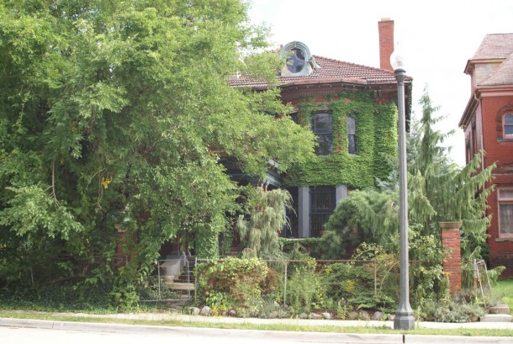
Not like this
source

Slide 6
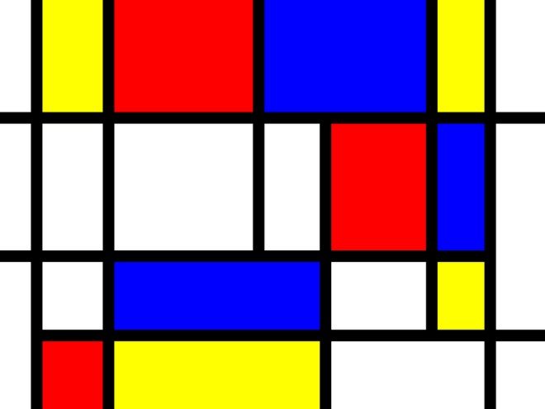
Your programs should look like this
source

Slide 7
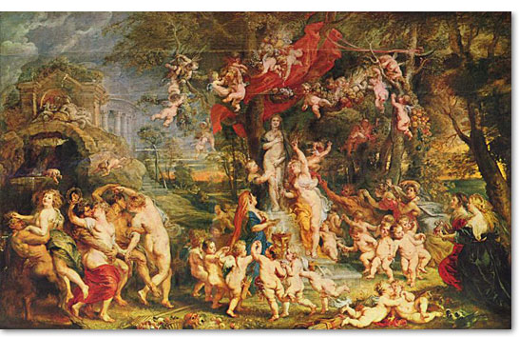
Not like this
source

Slide 8
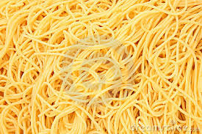
And never, ever like this
source

Slide 9
Principles for writing beautiful programs
1. Always remember: Programming is a People Discipline
2. Represent Information as Data; Interpret Data as Information
3. Programs should consist of functions and methods that consume and produce values
4. Design Functions Systematically
5. Design Systems Iteratively
6. Pass values when you can, share state only when you must.

Slide 10
Principles
Everything we do can be traced back to one or more of these principles.
We will expand on each of them as we go along.
Write these down, in your own handwriting. Writing things down will help you remember them.

Slide 11
A Few of Our Slogans
We are also big on slogans. We think they help focus your mind.
Here are our first few slogans. You should write them down, too, in your own handwriting.
In fact, whenever you see one of these blue tables, you should assume that this is something important, and you should probably write it down in your own handwriting so you can memorize it.

Slide 12
Some Slogans
1. Stick to the recipe!
2. You don't understand it until you can give an example.
3. One function, one task.
4. The Shape of the Data Determines the Shape of the Program.
5. Practice makes perfect.

Slide 13
The Function Design Recipe
The function design recipe is the most important thing in this course. It is the basis for everything we do.
It will give you a framework for attacking any programming problem, in any language. Indeed, students have reported that they have found it useful in other courses, and even in their everyday life.
With the recipe, you need never stare at an empty sheet of paper again.
Here it is:

Slide 14
The Function Design Recipe
The Function Design Recipe
1. Data Design
2. Contract and Purpose Statement
3. Examples and Tests
4. Design Strategy
5. Function Definition
6. Program Review
This is important. Write it down, in your own handwriting. Keep it with you at all times. Put it on your mirror. Put it under your pillow. I’m not kidding!
Notes:
Here is the function design recipe.

Slide 15
The Course Map
As we go through the course, we will learn about more and more complicated kinds of data design and design strategies. The map on the next slide, which we will show at the beginning of every module, will help you see where you are in the course content.

Slide 16
Course Map
Data Representations
Design Strategies
Basics
Combine simpler functions
Generalization
Mixed Data
Over Constants
Use a template
Recursive Data
Over Expressions
Divide into Cases
Functional Data
Over Contexts
Call a more general function
Objects & Classes
Over Data Representations
Stateful Objects
Communicate via State
Over Method Implementations

Slide 17
Next Steps
If you have questions about this lesson, ask them on Piazza
Go on to the next lesson

